Slide 1
Recursion

Slide 2
Introduction
Recursion is the process of a method calling itself as part of the solution to a problem.
It is a problem solving technique that can turn long and difficult solutions into compact and elegant answers.

Slide 3
Recursion
Recursion occurs when a method calls itself to solve another version of the same problem.

Slide 4
Recursion
With each recursive call, the problem becomes simpler and moves towards a base case.
A base case is when the solution to the problem can calculated without another recursive call.

Slide 5
Recursion
Recursion involves the internal use of a stack, a data concept that works like this:
New data is “pushed” or added to the top of the stack.
When information is removed from the stack it is “popped” or removed from the top of the stack.
The recursive calls of a method will be stored on a stack and manipulated in a similar manner.

Slide 6
Recursion Example
Base case is extremely important!
If you do not have one, the method will go on for ever and ever!
public void countDown(int num){
if(num == 0){
System.out.println(“Blast off!”);
}
else{
System.out.println(num);
countDown(num – 1);
}
}

Slide 7
Recursion Example
countDown(3)
countDown(3)
countDown(2)
public void countDown(int num){
if(num == 0){
System.out.println(“Blast off!”);
}
else{
System.out.println(num);
countDown(num – 1);
}
}
countDown(2)
countDown(1)
countDown(1)
countDown(0)
countDown(0)

Slide 8
Recursion
The problem of computing factorials is our first example of recursion. The factorial operation in mathematics is illustrated below.
1! = 1
2! = 2 * 1 or 2 * 1!
3! = 3 * 2 * 1 or 3 * 2!
4! = 4 * 3 * 2 *1 or 4 * 3!

Slide 9
Recursion
1! = 1
2! = 2 * 1 or 2 * 1!
3! = 3 * 2 * 1 or 3 * 2!
4! = 4 * 3 * 2 *1 or 4 * 3!
Notice that each successive line can be solved in terms of the previous line. For example, 4! is equivalent to
4 * 3!

Slide 10
Factorials
A recursive method to solve the factorial problem is given on the next slide. Notice the recursive call in the last line of the method.
The method calls another implementation of itself to solve a smaller version of the problem.

Slide 11
Factorials
int fact(int n){
// returns the value of n!
// precondition: n >= 1
if (n == 1){
return 1;
}
else{
return n * fact(n - 1);
}
}
1! is by definition 1, no further work is needed.
Each recursive method must have at least one base case.

Slide 12
Factorials
int fact(int n){
// returns the value of n!
// precondition: n >= 1
if (n == 1){
return 1;
}
else{
return n * fact(n - 1);
}
}
fact(4): This is not the base case (1 == n), so we return the result of 4 * fact(3).
This multiplication will not be carried out until an answer is found for fact(3). This leads to the second call of fact to solve fact(3).

Slide 13
Factorials
int fact(int n){
// returns the value of n!
// precondition: n >= 1
if (n == 1){
return 1;
}
else{
return n * fact(n - 1);
}
}
fact(3): Again, this is not the base case and we return
3 * fact (2). This leads to another recursive call to solve fact(2).

Slide 14
Factorials
int fact(int n){
// returns the value of n!
// precondition: n >= 1
if (n == 1){
return 1;
}
else{
return n * fact(n - 1);
}
}
fact(2): Still, this is not the base case, we solve 2 * fact(1).

Slide 15
Factorials
int fact(int n){
// returns the value of n!
// precondition: n >= 1
if (n == 1){
return 1;
}
else{
return n * fact(n - 1);
}
}
fact(1): Finally we reach the base case, which returns the value 1.

Slide 16
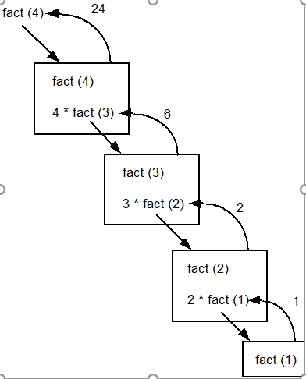
Factorials
When the base case is encountered, the recursion will now unwind and result in a final answer. The expressions below should be read from right to left.
fact(4)
= 4 * fact(3)
= 3 * fact(2)
= 2 * fact(1)
= 1
24 ← 4 * 6 ← 3 * 2 ← 2 * 1

Slide 17
Practice
To provide some practice, write a recursive power method that raises a base to some exponent, n. Use integers to keep things simple.
double power(int base, int n){
// Recursively determines base raised to
// the nth power. Assumes 0 <= n <= 10.
}

